Slide 1
HudsonAlpha BioTrain Computational Bootcamp

Slide 2
Computer Setup
https://james-lawlor.github.io/biotrain-2023/
Setup Bash (FOR TODAY)
(Windows) Download Git BASH http://www.gitforwindows.org
(Mac) Included. Open the “Terminal” application. Type bash and hit enter.
We will walk through data download together as a group using commands from james-lawlor.github.io
Install R (FOR TOMORROW) https://cran.rstudio.com/
Install RStudio Desktop https://www.rstudio.com/products/rstudio/download/#download

Slide 3
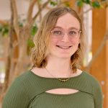
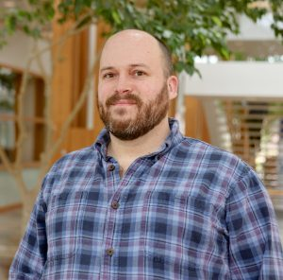
Your Instructors
James Lawlor, MS (he/him)
Computational Biologist, Greg Cooper Lab
Focus: Genomic Diagnoses
Belle Moyers, PhD (she/her)
Senior Scientist, Myers Lab
Focus: Gene Regulation

Slide 4
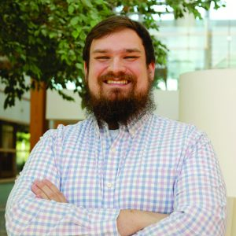
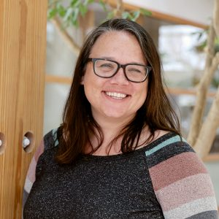
Your Helpers
Zach Bonnstetter, MS (he/him)
Stephanie Felker, PhD (she/her)

Slide 5
Wednesday Agenda
What is Computational Biology?
Computational Biology in the Cooper Lab
Keeping a Computational Lab Notebook
Unix Fundamentals
Introducing the Shell
Navigating Files and Directories
Working With Files and Directories
Pipes, Filters, and Loops (brief overview of advanced topics)
Continued Learning: Where to go next?

Slide 6
Thursday Agenda
Computational Biology Examples in the Myers Lab
Bootcamp Intro
Goals
Helpers & Post-Its
Why learn Unix & R?
Programming with R
Analyzing Biology Data
Writing Functions
Using For Loops to Analyze Multiple Data Sets
Getting Programming Help

Slide 7
Introduction to Biology with Computers
James Lawlor & Belle Moyers

Slide 8
What is computational biology?
“Computational biology and bioinformatics is an interdisciplinary field that develops and applies computational methods to analyze large collections of biological data, such as genetic sequences, cell populations or protein samples, to make new predictions or discover new biology.” -- Nature.com

Slide 9
In other words…
Use computational tools
Programming
Mathematical models & machine learning
Databases
Physics simulations
To analyze huge sets of data
Genome sequencing
Protein modeling
And answer biological questions
How does this gene work?
Does this disease have a genetic pattern?
How are these species related?
What makes a liver cell different from a brain cell?

Slide 10
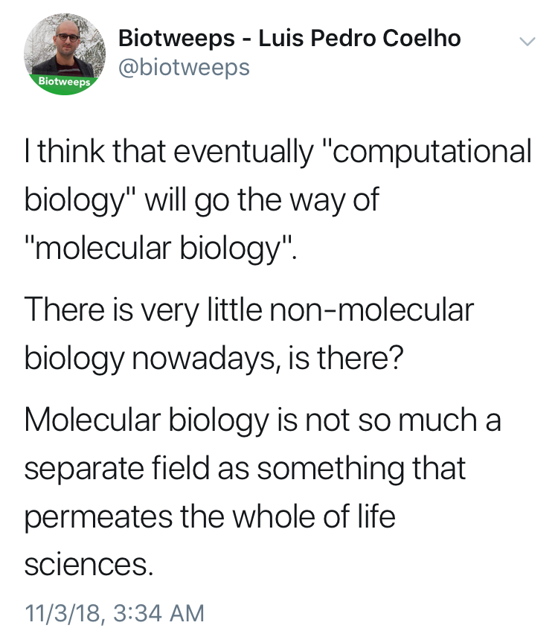

Slide 11
Terminology
The terms “bioinformatics” and “computational biology” are often used interchangeably:
Bioinformatics: Software tools, databases, visualization methods
Computational Biology: Data analysis, algorithm development, mathematical modeling
Other terms for the intersection of biology / math / computer science:
Data Science, Systems Biology, Statistical Biology, Biostatistics, Genomics (implicit), _____omics, Clinical Informatics, etc…

Slide 12
The bottom line:
Computational skills are increasingly critical for biology & many other fields
Hands-on experience is a huge first step

Slide 13
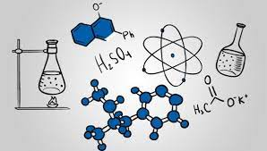



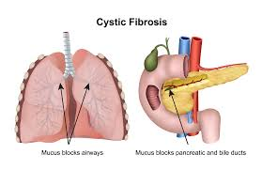
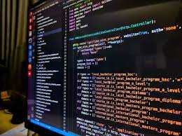

My Trajectory
BS: Biochemistry & Math
MS: Modeling & Simulation
Job: Missile Defense Cost Analyst
Job: Tutoring & Higher Ed.
Project: Cystic Fibrosis Genomics + Machine Learning
High School
HudsonAlpha Computational Biologist
Web & SQL
Difficult -> felt boring
Programming as a tool to solve interesting scientific problems

Slide 14
Why seek genetic diagnoses?
Notes:
* Why seek genetic diagnoses when we are already treating the symptoms of a disorder?

Slide 15
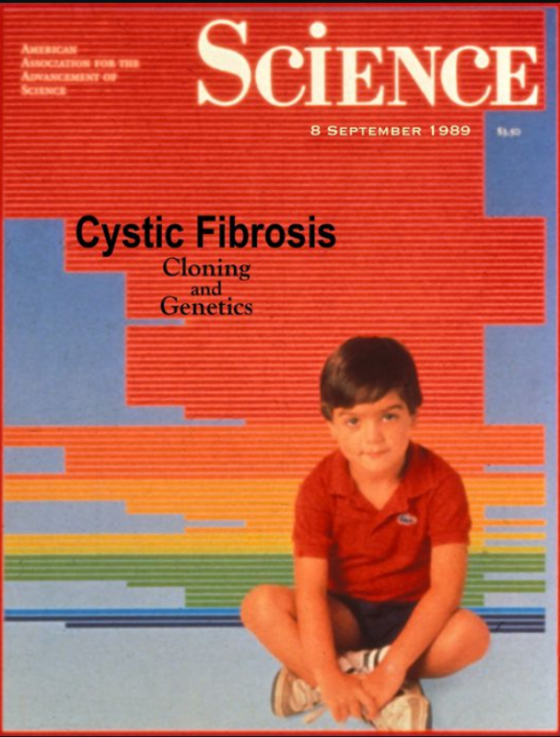
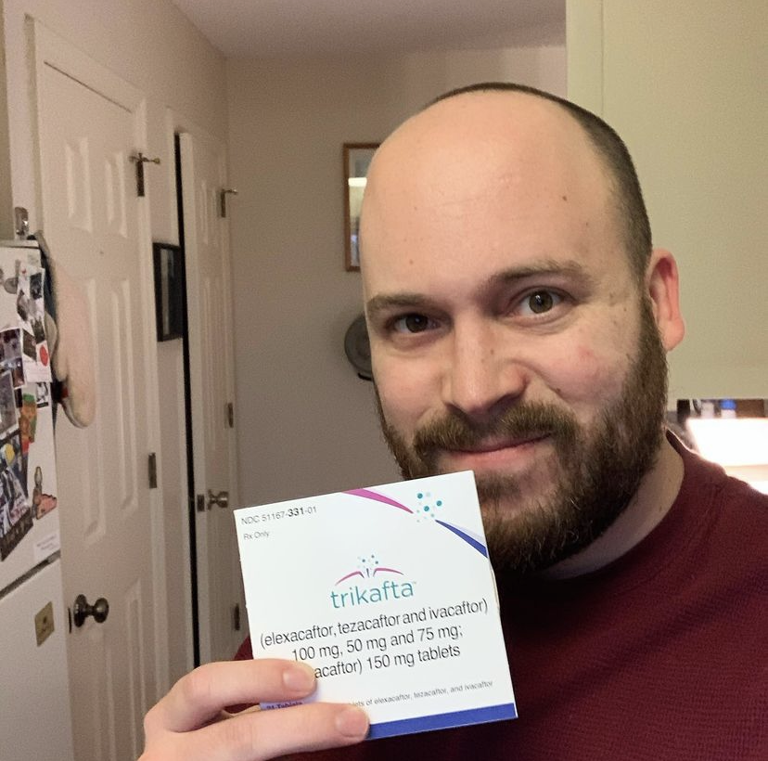
Disease-gene relationships are critical to scientific advancement & treatment
Basic Science: CFTR. (2017). Retrieved from http://www.hopkinscf.org
Notes:
But first I want to pause and reiterate why this basic science that does the work of linking new diseases to genes is so important. In my own life as a CF patient, I’ve been able to witness the direct impact of knowing precisely how a congential disease is affecting the patients on a genetic and molecular level. CFTR, the causative gene for Cystic Fibrosis, was found in 1989, and we eventually learned that it encodes a chloride channel whose malfunction causes the thick mucus that is the hallmark of this disease. This understanding has been critical to a majority of the treatments that I use every day. And that’s why

Slide 16
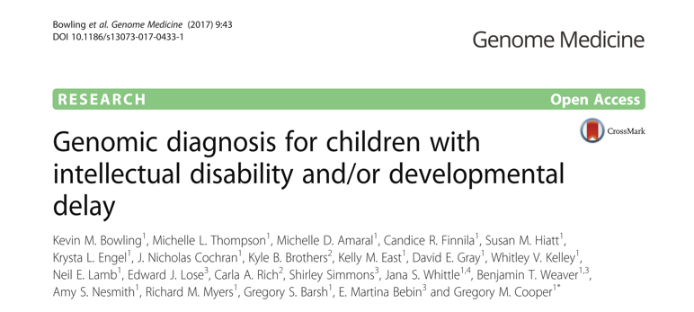
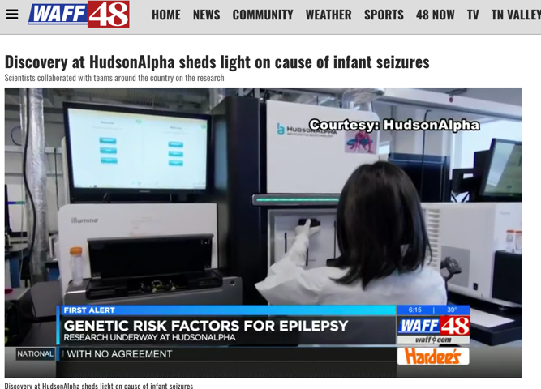
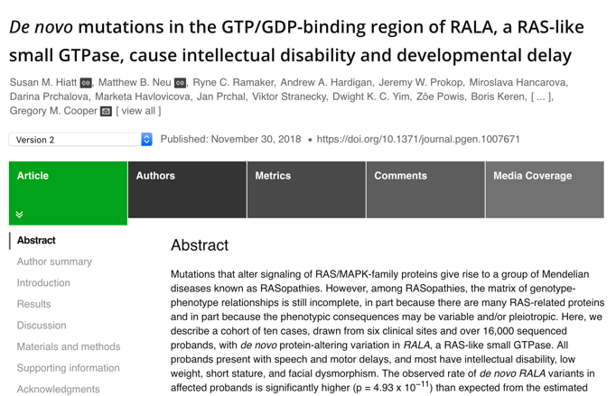
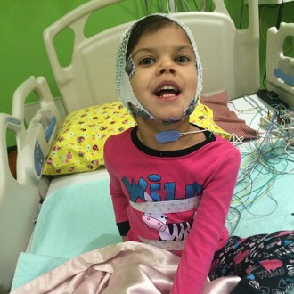
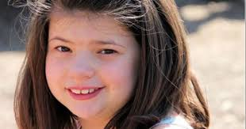
Disease-gene relationships are critical to scientific advancement & treatment

Slide 17

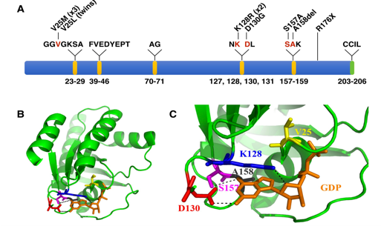
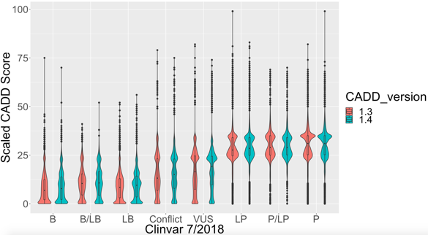
Our Goal: Increase Diagnoses
Describe new disease genes
Analyze more types of variation
Evaluate & improve computational models

Slide 18
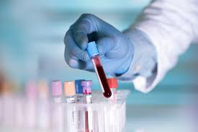
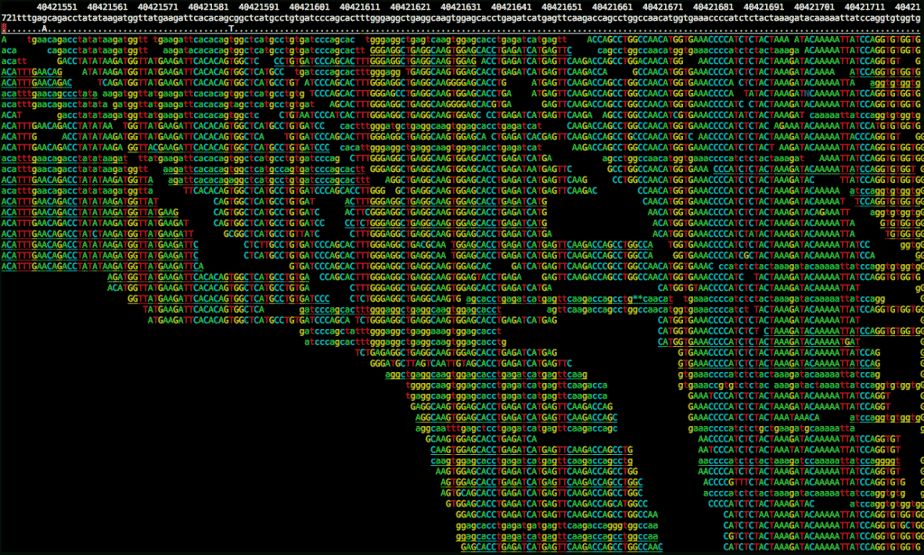

Challenge #1: Picturing the Whole Process

Slide 19
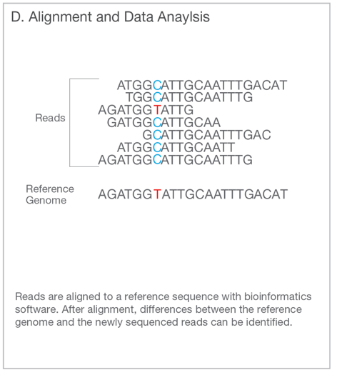
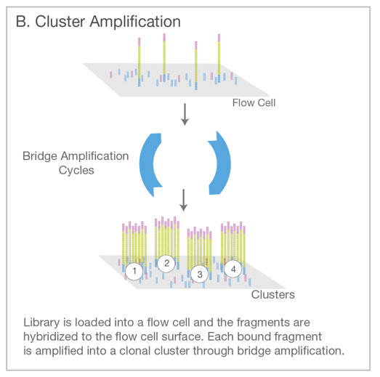
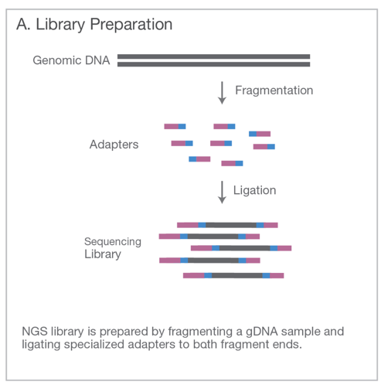
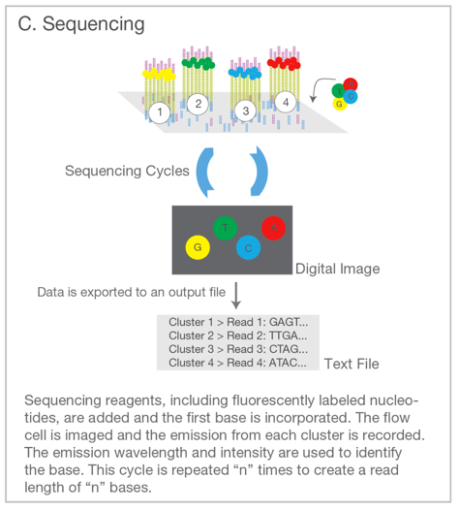
Genome Sequencing (Short Read)
Illumina. An introduction to Next-Generation Sequencing. (2017).

Slide 20

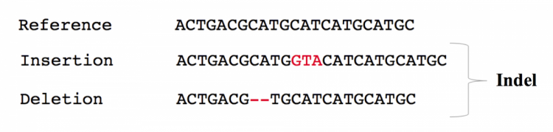
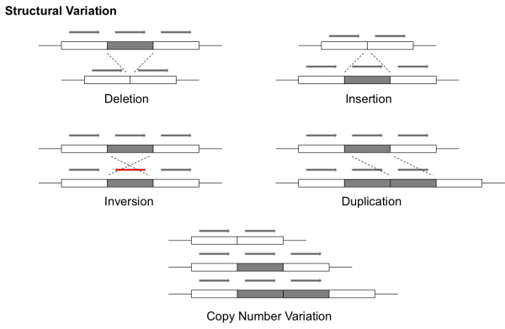
Result: Millions of variants for each person
Each kind of variation requires a different algorithm (or multiple algorithms) to detect from short read data.
EMBL. EMBL-EBI Training (2019).
Notes:
Since our focus is inherited disease, we’re looking at a patient’s DNA

Slide 21
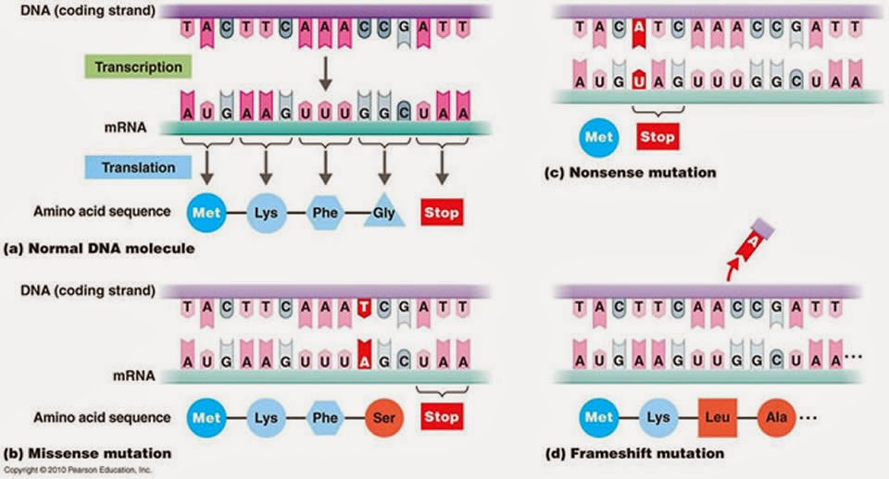
Best-understood variants alter proteins

Slide 22
Filtering / Analysis / Interpretation is key
~4,000,000 variants
population frequency
genomic annotations
computational predictions
inheritance pattern
clinical disease databases
phenotypes
published literature
~1 causal variant
We evaluate the totality of existing evidence for a particular variant

Slide 23
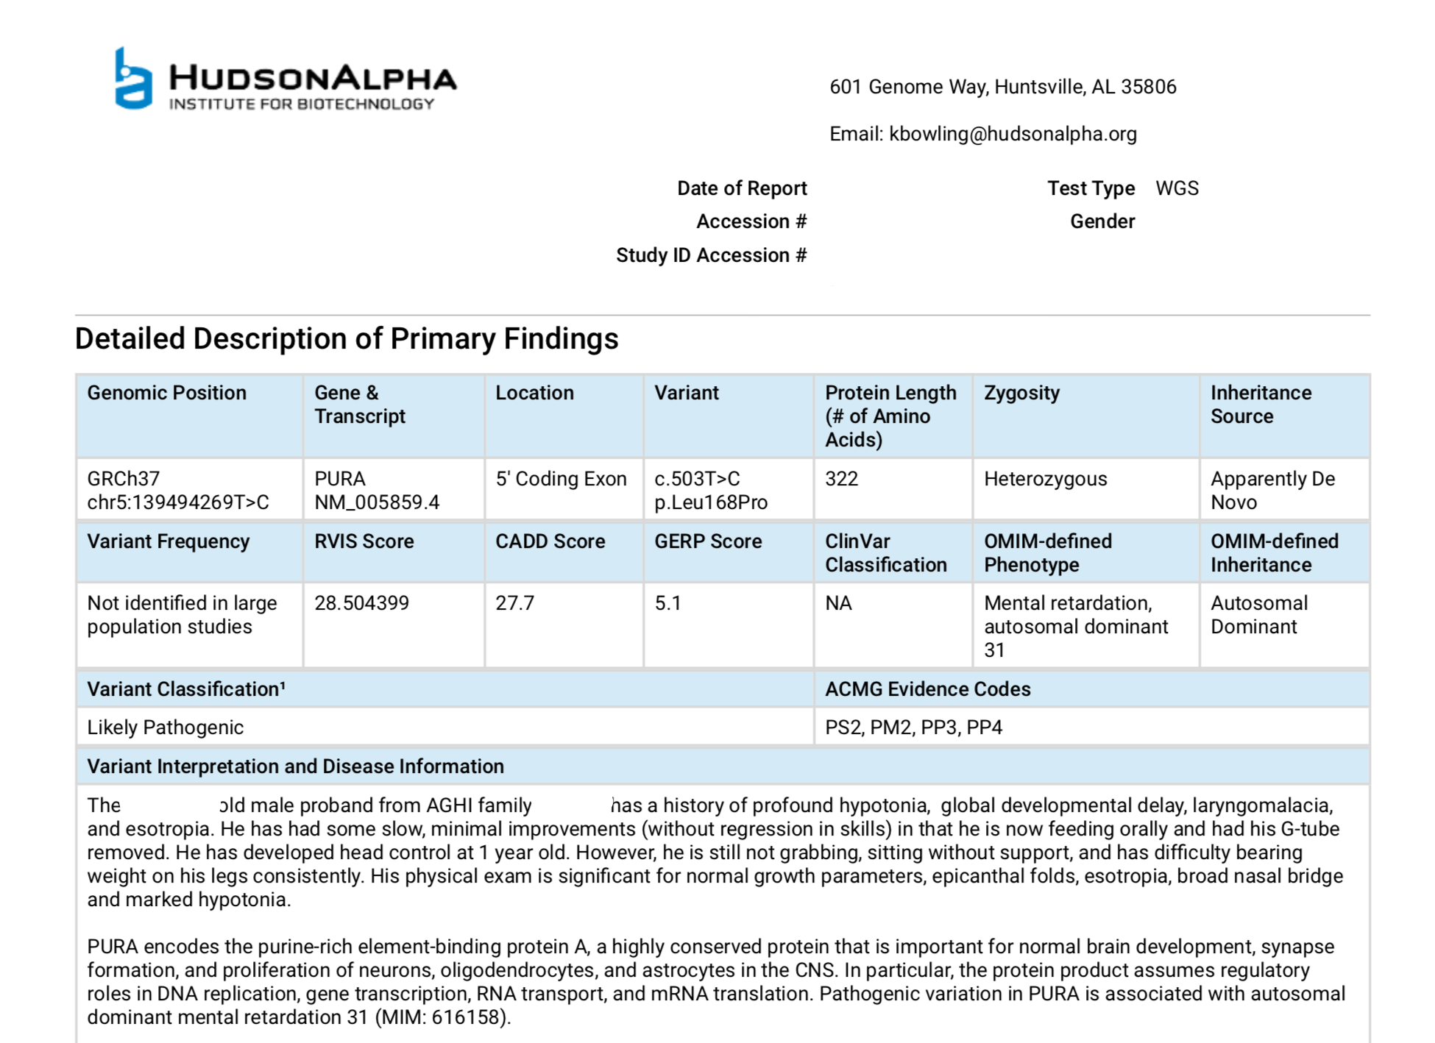

Slide 24


Slide 25
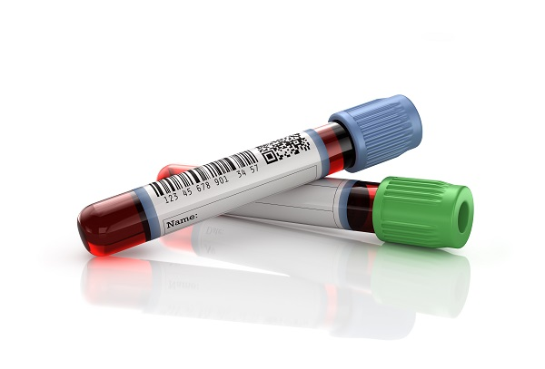
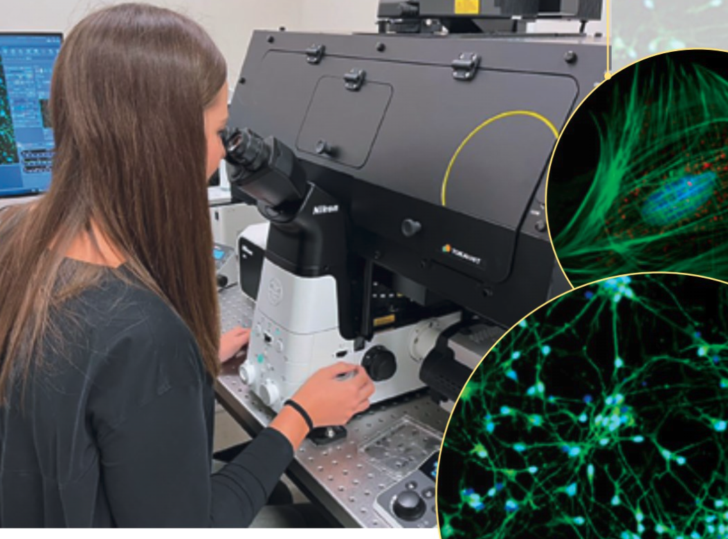
Sequencing
Variants
Ref & SW
Technology
QC + Accuracy
Sample
Type
ID codes
Conc.
Results
Patient
Symptoms
Diagnoses
Prior test results
Science
Ref Genome
Disease <-> Gene
Population variants
Func. predictions
Physician
Questions
Orders

Slide 26
Sequencing
Variants
Ref & SW
Technology
QC + Accuracy
Sample
Type
ID codes
Conc.
Results
Patient
Symptoms
Diagnoses
Prior test results
Science
Ref Genome
Disease <-> Gene
Population variants
Func. predictions
Physician
Questions
Orders

Slide 27


Challenge #2: Signal and Noise

Slide 28
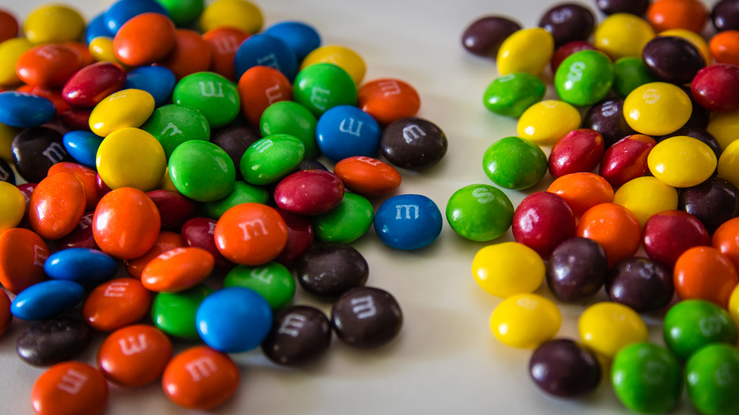
What’s your candy accuracy?

Slide 29
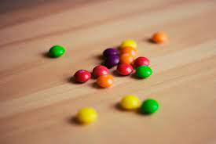
What’s your candy accuracy?

Slide 30

What’s your candy accuracy?

Slide 31
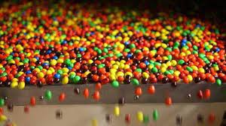
What’s your candy accuracy?

Slide 32
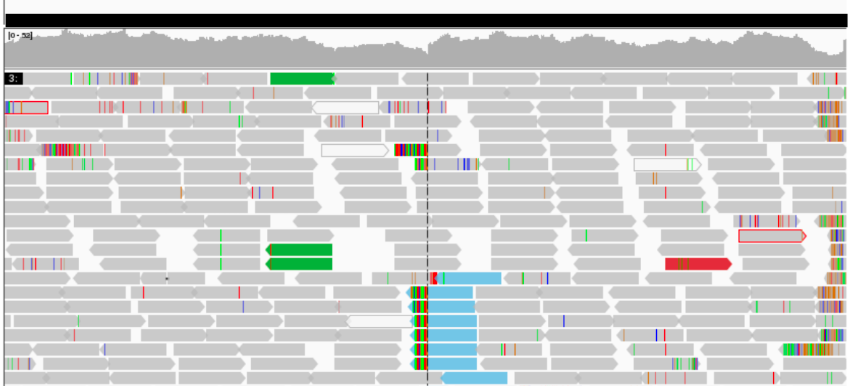
Genomics – Asking 6 billion questions at once

Slide 33
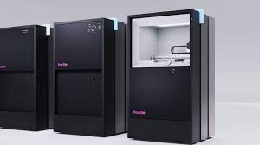
Challenge #3: Staying Current

Slide 34
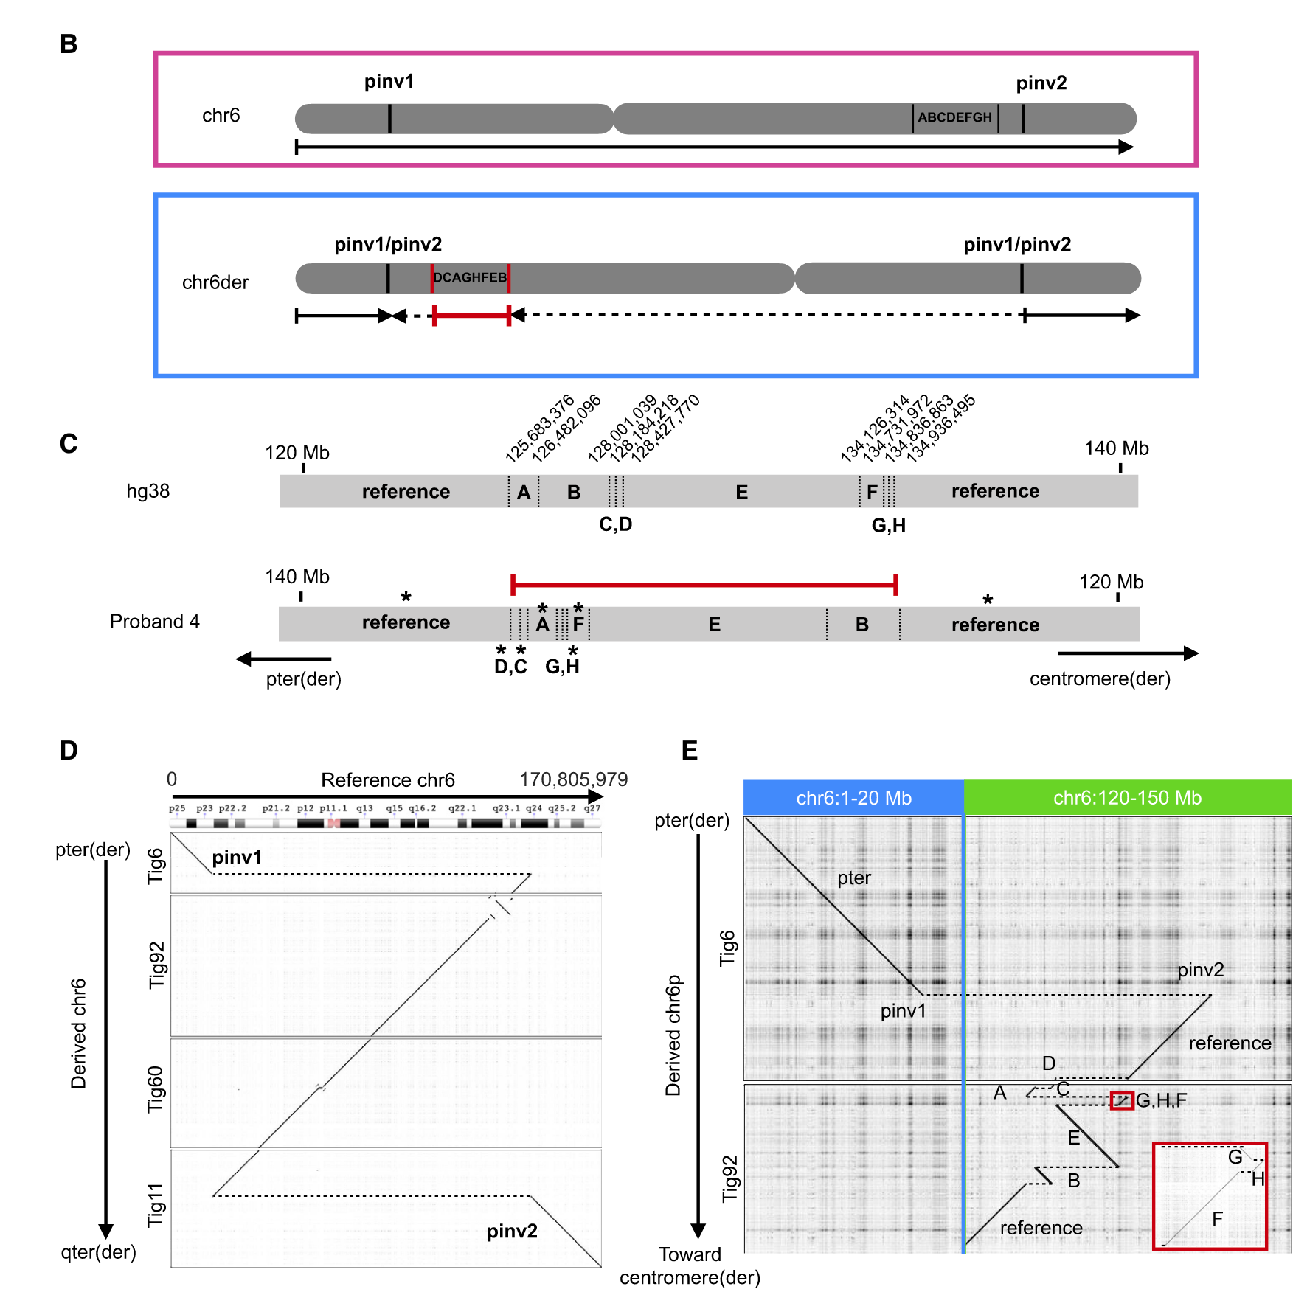
Long-Read Sequencing
Long-read:
What if we could
Read 20,000 DNA letters at a time
Instead of 150
Better resolution:
Repetitive areas of genome
Complex structural variants
Challenge:

Slide 35
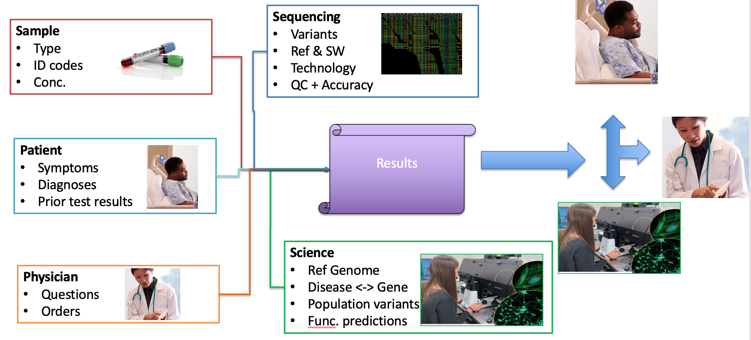
Long-Read Sequencing
Long-read:
What if we could
Read 20,000 DNA letters at a time
Instead of 150
Better resolution:
Repetitive areas of genome
Complex structural variants
Challenge:
Re-think your approach to Q#1 and Q#2!

Slide 36

Typical Day
Ask questions:
What can I explore today?
How can I make this process…?
Faster
More reliable
More informative
Evaluate existing tools
Write code
Python
R
Bash
Write about what I did:
For myself
For my collaborators
For the bigger scientific community

Slide 37
Critical Skills
Tech
Science
Communication
Troubleshooting
New languages & tools
Programming
Tech writing
Public speaking
Teamwork
"Translating"
Genetics & Biochemistry
Statistics
Compute clusters
Scientific Literature
Unix
Business Process
Automation
Documentation
Data management

Slide 38
Summary
Bioinformatics skills are critical to providing genetic diagnoses and learning new biology
Genomics requires team science & contributions from diverse skills
The intersection of biology and computational science creates new ethical situations

Slide 39
Bootcamp Intro

Slide 40
Goals
Introduce computational biology through:
Discussion of real-world need for computational skills in genomics
Hands-on lessons from the Software Carpentry in R & Unix Shell
After today, we will be able to:
Navigate files and folders on a Unix system
Create, copy, move, delete, and find files and folders
Record work in a computational lab notebook
After tomorrow we will be able to:
Read and manipulate data in the R programming language
Use programming concepts in R: Functions and For Loops *
Know where to learn more and how to ask for help

Slide 41
Flow
Discuss concepts -> work exercises -> review together
Website has links to reading/example material: http://james-lawlor.github.io/biotrain-2023
Asking questions = better experience for everyone
Live feedback with post-its:
Green post-it on computer: The pace is good and I’m keeping up
Red post-it on computer: I’d like a helper / Slow down!
Helpers: Experienced helpers are available for one-on-one help as we’re working

Slide 42
Why learn Unix and R?
Unix lets us access high-performance computing environments and industry-standard software
Easy way to introduce fundamental concepts about programming and computers:
Let the computer do the work for you instead of repeating yourself
Save your “program” so you can re-use it later
Learn to combine small tools into a more complex behavior
Learn to troubleshoot problems (of any kind)
A little hands-on experience goes a long way

Slide 43
~ 10 minute Break

